Slide 1

Slides for Chapter 10:
Peer-to-Peer Systems
From Coulouris, Dollimore and Kindberg
Distributed Systems:
Concepts and Design
Edition 4, © Addison-Wesley 2005

Slide 2
Peer to Peer Systems - Introduction
“Applications that exploit resources available at the edges of the Internet including storage, cycles, content and human presence” [Shirky 2000]

Slide 3
Peer to Peer Systems - Introduction
Placement of data objects across many hosts
Ability to access data with minimum overhead
Exploit existing services such as naming, routing, data replication and security
Provide file sharing, web caching, information distribution
Best used for fairly static data

Slide 4
Peer to Peer Systems - Scalability
Not feasible to have a single service provider
  Administration and fault recovery dominate
  Large bandwidth requirement with high dependence
  Difference between server and desktop machines diminishing

Slide 5
Peer to Peer - Characteristics
Design must insure each user contributes resources to the system
All nodes need the same functional capabilities and responsibilities
Correct operation does not depend on the existence of any centrally administered system
The system offers a degree of anonymity
Workload must be balanced and availability must be ensured with minimum overhead

Slide 6
Peer to Peer: Issues
Computers and networks are volatile resources and owners are under no obligation to keep them switched on.
Users cannot be guaranteed access to a resource however if there are multiple copies of a data object the probability of not being able to access the object is low.

Slide 7
Peer to Peer - Examples
First generation
Napster – Music exchange (2001)
Second Generation
Freenet - file exchange (2000)
Gnutella, Kazaa, BitTorrent (2000-2004)
Third generation
Pastry, Tapestry, CAN, Chord, Kademlia. Middleware layers (2001-2004)

Slide 8
Peer to Peer – Third Generation (Overlay routing)
First and second generation peer-to-peer applications are based on IPv4 and IPv6.
Large chunks of IPv4 and IPv6 are pre allocated and thus unavailable.
Third generation:
  Uses a uniform 2*128 name space
  Derives a GUID from the resources state (e.g. by using a secure hash function), which must be immutable.

Slide 9
Peer to Peer Secure: Secure Digest Function
Given a file f a function H should be used to calculate a fixed length hash (e.g. 2^128 bits)
  h = H(f)
  h should be randomly distributed in the over the entire address space
It should be difficult to calculate f = H”(h)

Slide 10
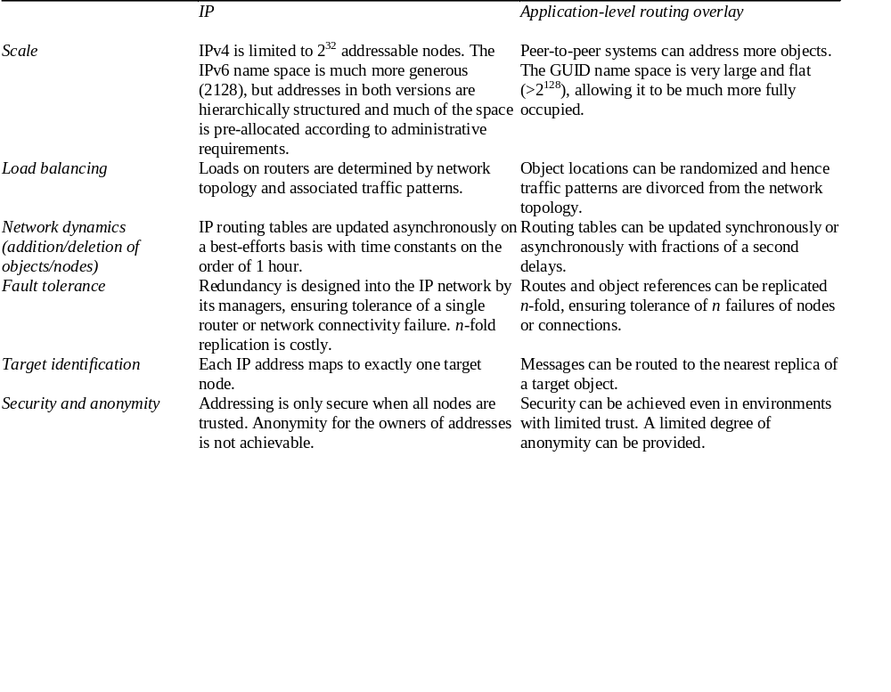
Figure 10.1: Distinctions between IP and overlay routing for peer-to-peer applications

Slide 11
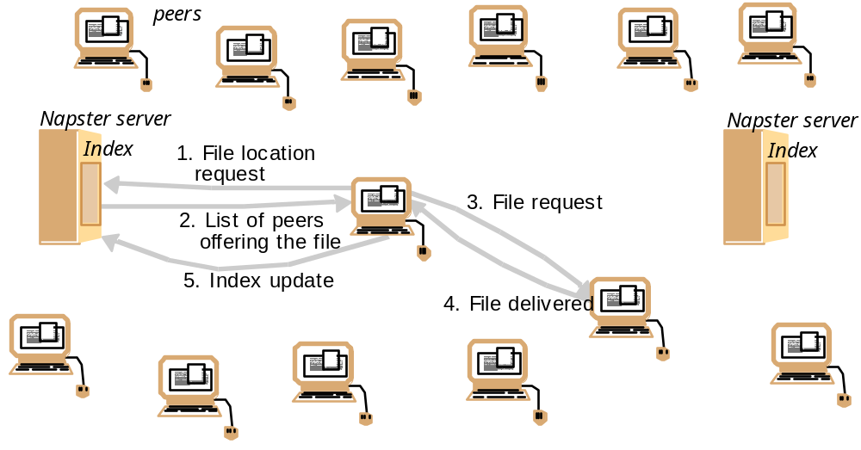
Figure 10.2: Napster: peer-to-peer file sharing with a centralized, replicated index

Slide 12
Napstar - 1999
First application for globally-scaleable information storage
Centralised indexes
User supplied files
“Fairness Policy” - if you use then contribute
Shut down –
  Napster claimed they were not participating in the copying of files
  BUT the index servers had well known addresses and were unable to remain anonymous

Slide 13
Napstar – 1999 Lessons learnt
Feasibility of using end user clients to implement a distributed application
Identified need for fair distribution of requests to share data
Use network locality where possible
Limitations
  Napster used replicated databases but the nature of the application did not require high consistency. Most application need greater consistency
  Music files never updated
  No guarantees of availability – wait for music to appear

Slide 14
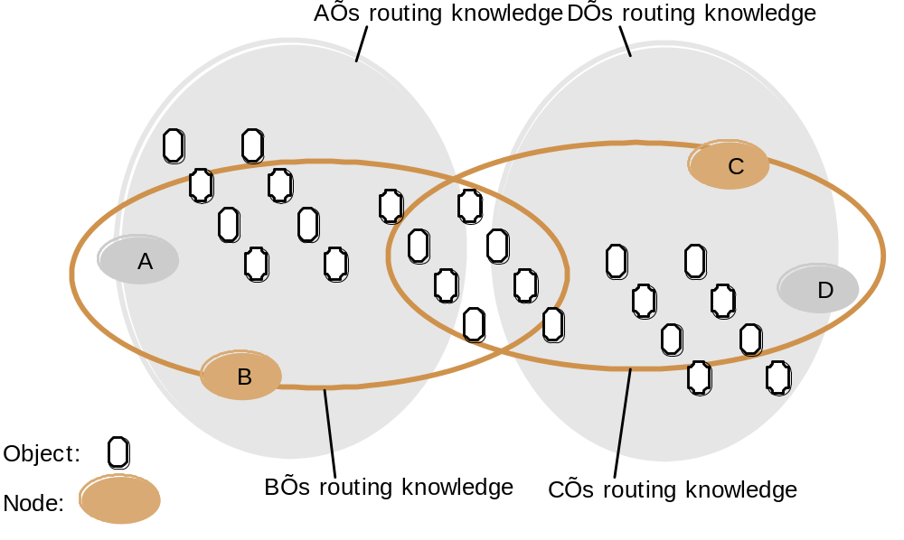
Figure 10.3: Distribution of information in a routing overlay

Slide 15
Figure 10.4: Basic programming interface for a distributed hash table (DHT) as implemented by the PAST API over Pastry
put(GUID, data)
The data is stored in replicas at all nodes responsible for the object identified by GUID.
remove(GUID)
Deletes all references to GUID and the associated data.
value = get(GUID)
The data associated with GUID is retrieved from one of the nodes responsible it.

Slide 16
Figure 10.5: Basic programming interface for distributed object location and routing (DOLR) as implemented by Tapestry
publish(GUID )
GUID can be computed from the object (or some part of it, e.g. its name). This function makes the node performing a publish operation the host for the object corresponding to GUID.
unpublish(GUID)
Makes the object corresponding to GUID inaccessible.
sendToObj(msg, GUID, [n])
Following the object-oriented paradigm, an invocation message is sent to an object in order to access it. This might be a request to open a TCP connection for data transfer or to return a message containing all or part of the object’s state. The final optional parameter [n], if present, requests the delivery of the same message to n replicas of the object.

Slide 17
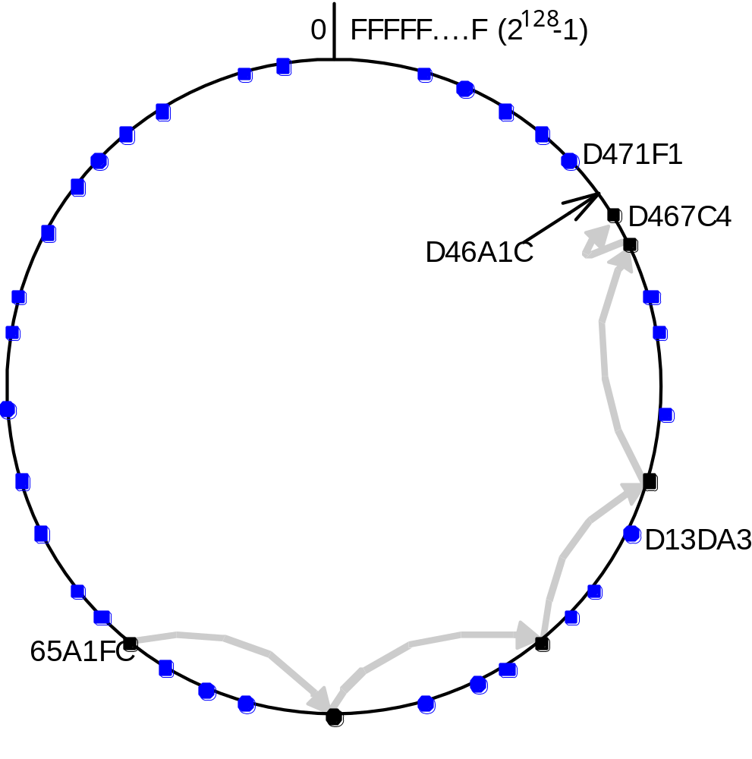
Figure 10.6: Circular routing alone is correct but inefficient
Based on Rowstron and Druschel [2001]
The dots depict live nodes. The space is considered as circular: node 0 is adjacent to node (2¹²⁸-1). The diagram illustrates the routing of a message from node 65A1FC to D46A1C using leaf set information alone, assuming leaf sets of size 8 (l = 4). This is a degenerate type of routing that would scale very poorly; it is not used in practice.

Slide 18
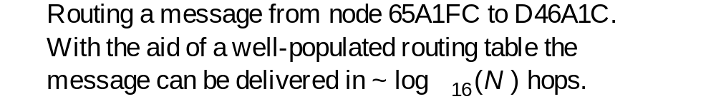
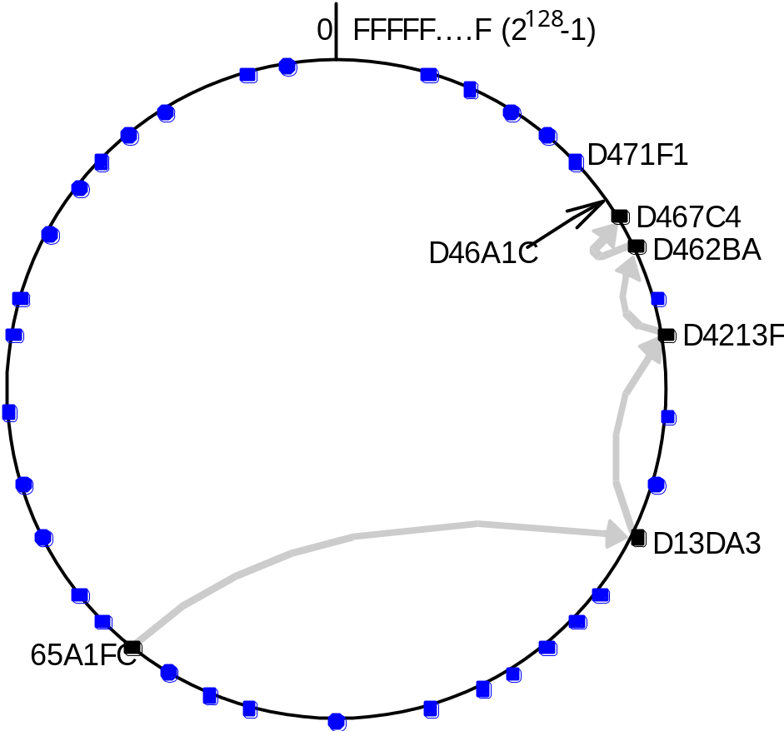
Figure 10.8: Pastry routing example Based on Rowstron and Druschel [2001]

Slide 19
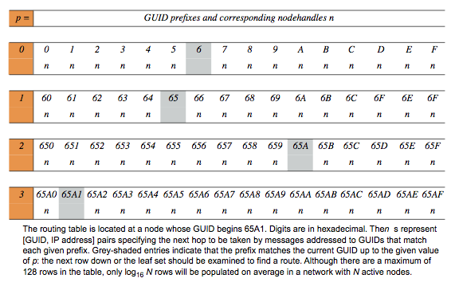
Figure 10.7: First four rows of a Pastry routing table

Slide 20
BitTorrent
BitTorrent –
  Enables efficient transfer of (large) files from a remote server to a client machine.
  Original Client developed by Ludvig Strigeas
  Many other clients exist
  Just another protocol!
  References http://bittorrent.org

Slide 21
BitTorrent Features
Small footprint
Bandwidth prioritization
Scheduling
RSS scheduling (see below)
Cuts files into small chunks (256K)
Uses Digital Hash Table (SHA1) to integrity
Protocol Encryption

Slide 22
Really Simple Syndication (1)
Family of web feed formats
Typically used for information that changes regularly e.g. Blog entries, weather updates, audio, video
User subscribes to ‘web feeds’, data is updated regularly.
Web feed includes data and meta data (data about data) that for example my describe how the data is displayed.
Web feeds can be customized to the receiving appliance

Slide 23
Really Simple Syndication (2)
An RSS reader can run on a desktop computer (or similar device) and request updates at regular intervals.

Slide 24
The Basics of BitTorrent (1)
A Peer to Peer architecture is one that that shares data between different systems. i.e. there is no central controller.
BitTorrent defines a Peer-to-Peer protocol
Peer-to-Peer systems should still be able to perform tasks even if part of the network is down.
The bittorrent protocol is attributed to Bram Cohen

Slide 25
The basics of BitTorrent (2)
Basic premise was to distribute data in such a way that the original distributor would be able to decrease the bandwidth usage while still being able to at least the same number of people.
The idea was to break the file into smaller segments called pieces.
To save bandwidth, each person downloading (a peer) would have the pieces they acquired available to other peers in the swarm (the entire network of people connected to a torrent).

Slide 26
The basics of BitTorrent (3)
A seed is a peer that has all every piece.
Over time a peer will acquire all pieces and become a seed themselves
The availability of a torrent is the number of complete copies of the in the swarm.
trackers provide a centralised service of keeping track to the other peers IP addresses (containing the files). For each given swarm a tracker only needs to collect a peers IP Address and port number.

Slide 27
The basics of BitTorrent (4)
BitTorrent speeds are not guaranteed for any torrent swarm.
Point to point protocols can be slow depending on network speeds and usage.
Swarms that contain more seeds and peers are not necessarily faster.
Trackers are often the bottleneck

Slide 28
The basics of BitTorrent (4)
Installation of client
  Install BitTorrent
  Surf the web required file
  Click where to save file locally
  Wait for download to complete
  Exit downloader

